Slide 1
Week 12a
COMPUTATIONAL MATHEMATICS
Shooting Method

Slide 2
Reference
Kisualaas, Jann. (2013). Numerical Methods in Engineering with Python 3. Cambridge University Press.
Johansson, Robert. (2015). Chapter 5. Equation Solving. Numerical Python: A Practical Techniques Approach for Industry, Apress.
Chapra, S. C., and Raymond P. Canale. (2010). Numerical methods for engineers, Sixth edition, McGraw Hill.
Kaw, A. (n.d.). Numerical Methods. Retrieved March 20, 2020, from https://nm.mathforcollege.com/

Slide 3
Shooting Method
The shooting method uses the methods used in solving initial value problems. This is done by assuming initial values that would have been given if the ordinary differential equation were a initial value problem. The boundary value obtained is compared with the actual boundary value. Using trial and error or some scientific approach, one tries to get as close to the boundary value as possible.
http://numericalmethods.eng.usf.edu

Slide 4
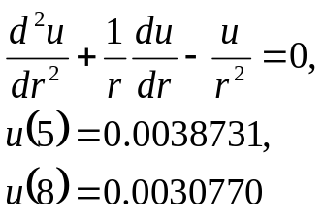
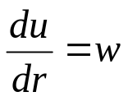
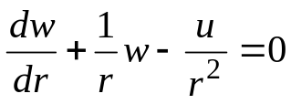
Example
r
a
b
Let
Where a = 5
and b = 8
Then
http://numericalmethods.eng.usf.edu

Slide 5





Solution
Two first order differential equations are given as
Let us assume
To set up initial value problem
http://numericalmethods.eng.usf.edu

Slide 6




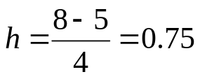
Solution Cont
Using Euler’s method,
Let us consider 4 segments between the two boundaries, and then,
http://numericalmethods.eng.usf.edu

Slide 7
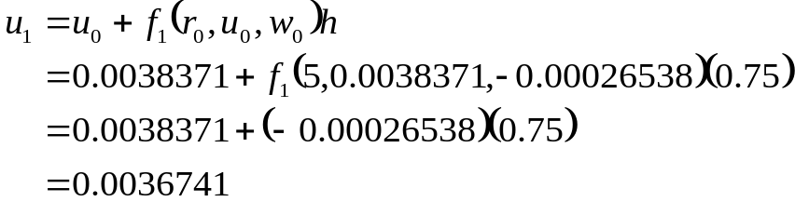
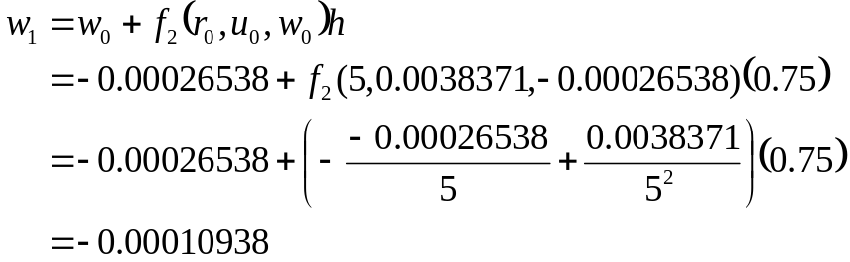
Solution Cont
For
http://numericalmethods.eng.usf.edu

Slide 8


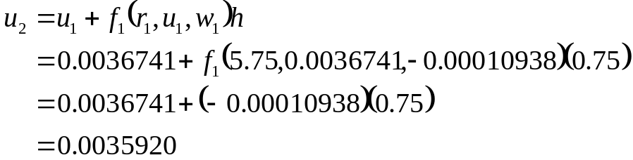
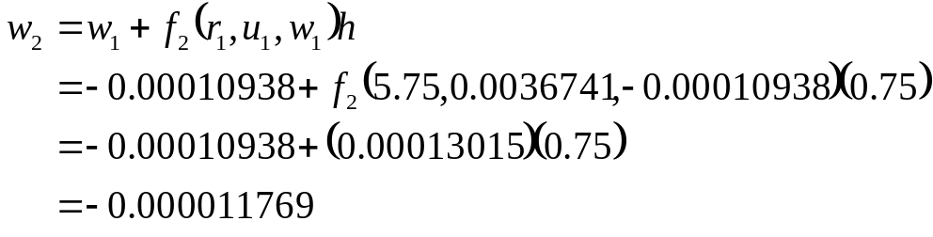
Solution Cont
For
http://numericalmethods.eng.usf.edu

Slide 9

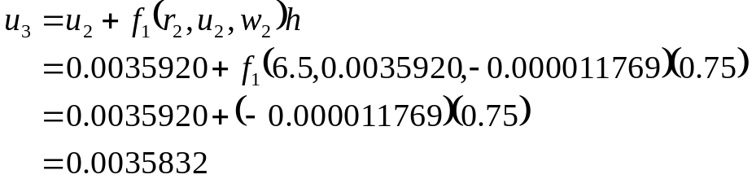
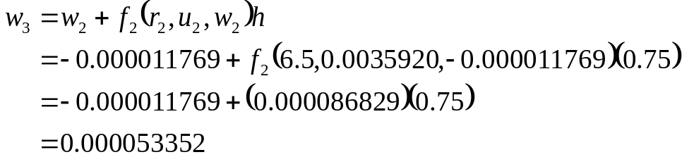
Solution Cont
For
http://numericalmethods.eng.usf.edu

Slide 10


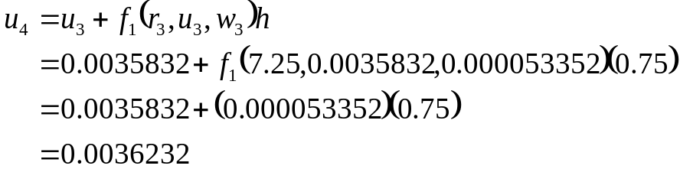
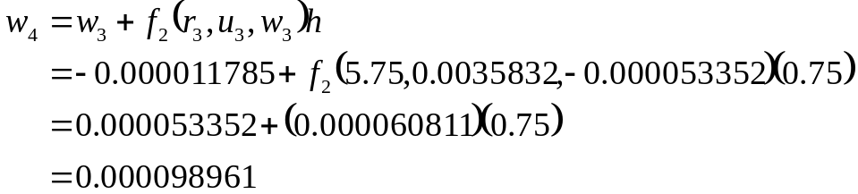


Solution Cont
For
So at
http://numericalmethods.eng.usf.edu

Slide 11




Solution Cont
Let us assume a new value for
Using
and Euler’s method, we get
While the given value of this boundary condition is
http://numericalmethods.eng.usf.edu

Slide 12






Solution Cont
Using linear interpolation on the obtained data for the two assumed values of
we get
Using
and repeating the Euler’s method with
http://numericalmethods.eng.usf.edu

Slide 13







Solution Cont
Using linear interpolation to refine the value of
till one gets close to the actual value of
which gives you,
http://numericalmethods.eng.usf.edu

Slide 14
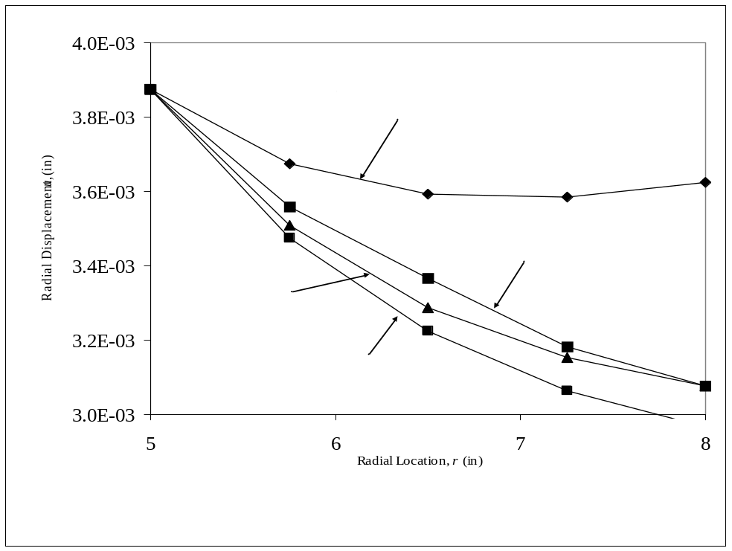
Comparisons of different initial guesses
http://numericalmethods.eng.usf.edu

Slide 15

Comparison of Euler and Runge-Kutta Results with exact results
Table 1 Comparison of Euler and Runge-Kutta results with exact results.
r (in) | Exact (in) | Euler (in) |  | Runge-Kutta (in)
5 5.75 6.5 7.25 8 | 3.8731×10⁻³ 3.5567×10⁻³ 3.3366×10⁻³ 3.1829×10⁻³ 3.0770×10⁻³ | 3.8731×10⁻³ 3.5085×10⁻³ 3.2858×10⁻³ 3.1518×10⁻³ 3.0770×10⁻³ | 0.0000 1.3731 1.5482 9.8967×10⁻¹ 1.9500×10⁻³ | 3.8731×10⁻³ 3.5554×10⁻³ 3.3341×10⁻³ 3.1792×10⁻³ 3.0723×10⁻³ | 0.0000 3.5824×10⁻² 7.4037×10⁻² 1.1612×10⁻¹ 1.5168×10⁻¹
http://numericalmethods.eng.usf.edu

Slide 16
Additional Resources
For all resources on this topic such as digital audiovisual lectures, primers, textbook chapters, multiple-choice tests, worksheets in MATLAB, MATHEMATICA, MathCad and MAPLE, blogs, related physical problems, please visit
http://numericalmethods.eng.usf.edu/topics/shooting_method.html

